Slide 1
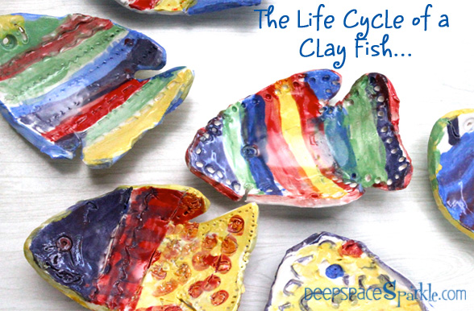

Slide 2
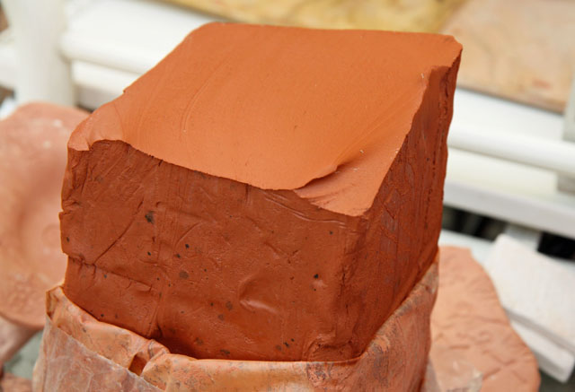
Clay is constantly being produced from the decomposition of certain igneous rocks.
The four miles of the earth’s crust is composed primarily of igneous rocks. As the
crust breaks down and decays from the weather, clay is formed.

Slide 3
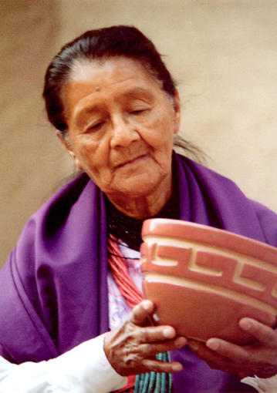
Ceramic objects have been found made by a wide variety of peoples across the
world from as early as Neolithic times. The objects made depended upon the needs
and beliefs of the culture that made them.

Slide 4
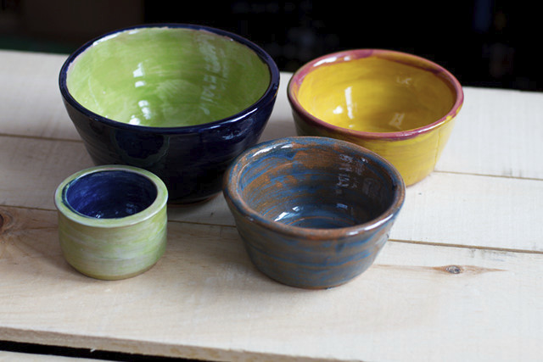
Objects were created for utilitarian use,
decoration, and ceremonial or religious reasons. Things made for utilitarian use
include containers, cooking or eating utensils.

Slide 5
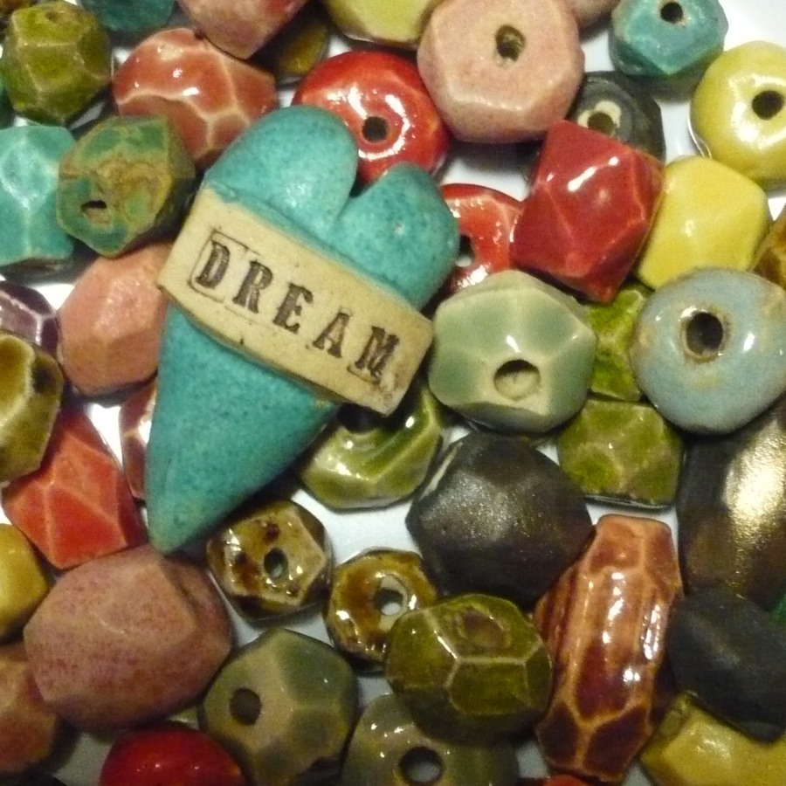
Objects for decoration included beads, buttons and
medallions; and, lastly, objects we believe to have been for ceremonial uses include
figurines, masks, rattles, drums, whistles, and flutes.

Slide 6
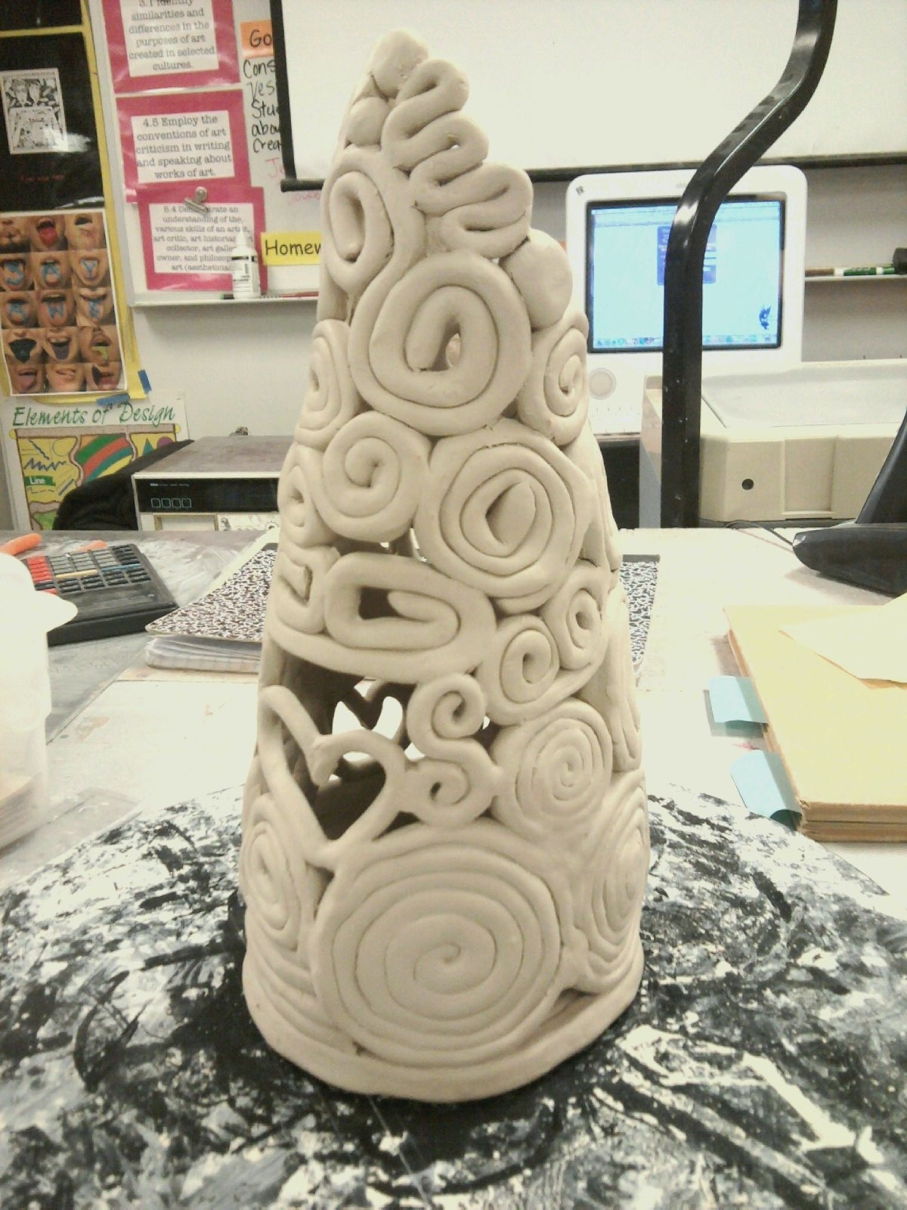

Slide 7
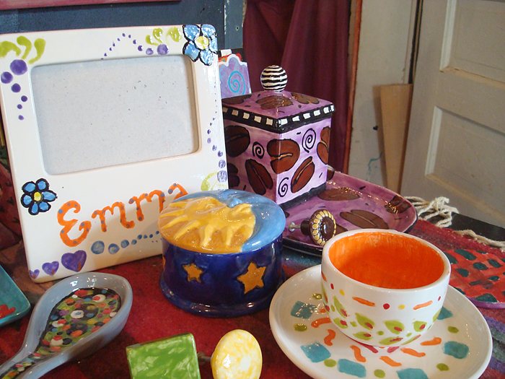

Slide 8
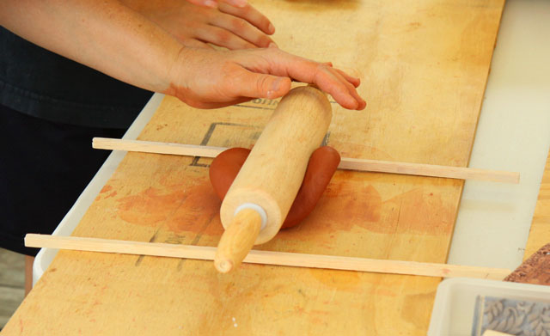

Slide 9
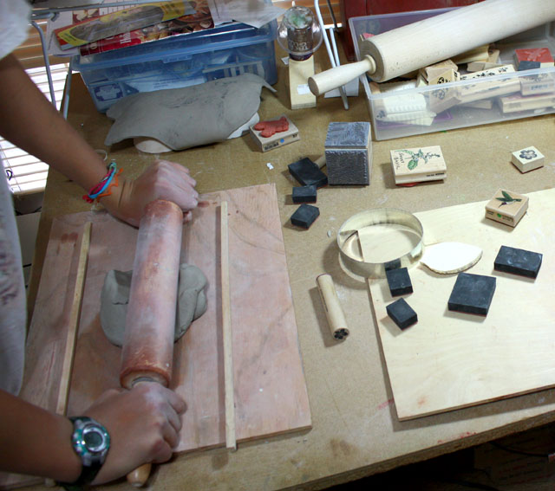

Slide 10
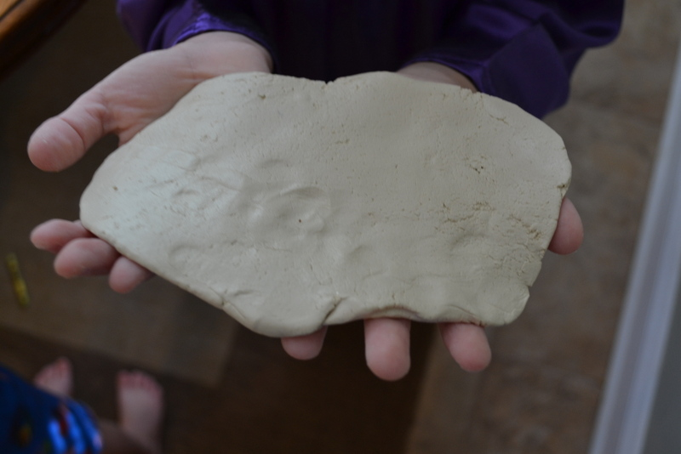
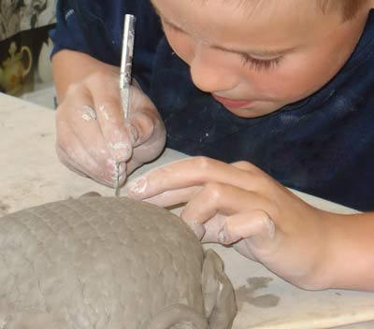
Working With Clay

Slide 11
Clay Bowls

